Slide 1
AP Statistics Chapter 8 REVIEW Binomial Distribution and Geometric Distribution

Slide 2
A manufacturer produces a large number of microwaves. From past observations, the manufacturers knows that approximately 3.5% are defective. A retail store purchases 4,500 microwaves.
a) Determine the probability that between 3% to 5% of microwaves purchased will be defective?
b) Check if the conditions to use a normal approximate are met
c) If more than 5% of microwaves are defective, the retail store will start a repair department. Should the company start a repair department?

Slide 3
In a large population of college students, 20% of students have symptoms of social anxiety. If you take a random sample of 15 students from this population, which expression is the probability that exactly 2 students have experienced social anxiety?

Slide 4
Jerry writes a MC test with 5 questions and each question has 4 choices. What is the probability that he gets less 80%?
a) binompdf(5,0.25,4)
b) binompdf(5,0.25,3)
c) binomcdf(5,0.25,4)
d) binomcdf(5,0.25,3)
e) binompdf(5,0.25,0) + binompdf(5,0.25,1) + binompdf(5,0.25,2) + binompdf(5,0.25,3)

Slide 5
Ex: “What do you think is the ideal number of children for a family to have?” A survey poll asked this question to 1006 randomly chosen adults. Almost half (49%) think two children was ideal. Suppose that p = 0.49 [49% of the population proportion believe that two children was ideal] a) What is the random variable “X”? Is the distribution of “X” binomial? Check the four conditions for a binomial setting
b) Find the mean and standard deviation of X.
c) Find the probability that X = 493.
d) Find the probability that X is within two standard deviations of the mean
e) Describe the distribution of the binomial random variable X.
f) Can you use a Normal distribution to approximate the binomial distribution? What conditions must be met?
g) Use the Normal approximation to find the area between two standard deviations of the mean
h) The results in Questions “d” and “g” should be extremely close. Why would this be so? Explain

Slide 6
Let X be number of adults that two children was ideal in a family.
a)There are two outcomes: Thinking who children is ideal (success) and not thinking two children is ideal (Failure). The probability of success (0.49) is the same for each trial. The trials are independent, and there is a fixed number of trials (1006)
b)
c)
d)
e) The binomial distribution is approximately normal with a mean of 492.94 and a standard deviation of 15.856
f)
G) Larger sample sizes give better approximations to the normal distribution. So the Normal approximation estimation will be close to the binomial probability

Slide 7
General Formula for Binomial Distribution:
Ex: Suppose we have a random variable “X’ where for the values “m” we have m=0,1,2,3,….20. The associated probabilities are given by the formula:
What is the mean and std dev. of “X”?

Slide 8
Q: Challenge: Which of the following statements is incorrect?
a) The histogram of a binomial distribution with p=0.5 is always symmetric no matter what the value of “n”, the number of trials
b) The histogram of a binomial distribution with p=0.9 is skewed to the right
c) The histogram of a binomial distribution with p=0.9 is unimodal
d) The histogram of a binomial distribution with p=0.99 looks more and more symmetric, the larger the value of “n”
e)The histogram of a binomial distribution with p=0.999 looks more and more like a normal distribution, the larger the value of “n”

Slide 9
Ex: A survey is conducted with a sample size of 500 on the approval of the government’s spending in BC. Suppose 65% of BC’s population approve of the spending.
a) What is the random variable X? Is it binomial?
b) Calculate the binomial probability that atmost 330 adults in sample approve of government spending
c) Find the mean and standard deviation in the sample who indicate approval
d) Perform a normal approximation to the question in (b). How close is the normal approximation compared to the binomial distribution?

Slide 10
a) X = the number of people that approve of the BC’s governments spending in a sample of 500 people.
X is B(n,p) because the four conditions are satisfied 1. Each trial is independent
2. There are two outcomes: some approves (p=0.65) or disapproves (q=0.35)
3. There is a fixed number of people interviewed (n=500)
4. The probability for success is the same in each trial
b)
c)
d)

Slide 11
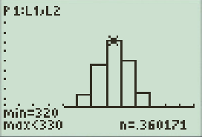
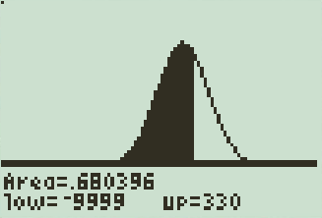
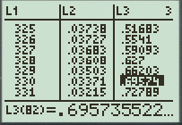
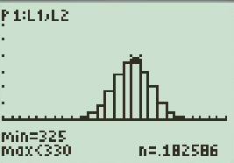
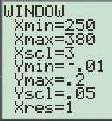
Binomial Distribution vs Normal Distribution

Slide 12
A battery manufacturing company claims that only 1.5% of their batteries are defective. An independent quality control company is hired to test this claim. They purchased 450 batteries and found that 14 of them were defective. Using the sample obtained, is it likely that only 1.5% of the batteries manufactured are defective? Explain:

Slide 13
Given two independent random variables “x” and “y”, where E(x) = 450, var(x)=60, E(y)=640, and var(y)=55. Evaluate each of the following:
a) E(x+y) b) E(x-y) c) var(x+y)
d) var(x-y) e) var(2x-3y)

Slide 14
A Bosch dishwasher cost $1200 and a 1 year warranty would cost $150. 1500 dishwashers were observed and the distribution of cost of repair within a year is illustrated below.
Cost: $0 $ 200 $400 $600 $1000 or more
Percentage: 99% 0.5 % 0.3% 0.15% 0.05%
Q: Is it worth buying the warranty? Explain:

Slide 16
Binomial vs Geometric:
Binomial Distribution: events that have only two outcomes:
Ie: Wrong/Right, up/down, Yes/No, Good/Bad, Black/White
With Bin. Dist. you want to find the number of successes within “n” trials
Ie: I flip 10 coins, how many heads will I get, I have six babies, how many of them will be girls
Geometric: events that have only two outcomes:
Goal: How many trials do I need until I get my first success
Ie: How many times I need to roll a dice until I get a 6
How many times I need to take my drivers test until I pass
Theoretically, the number of trials can be infinite

Slide 17
Conditions: Binomial Distributions
i: There can only be two outcomes
ii) Each trial must be independent
Outcome of any individual trial doesn’t affect the probabilities in other trials
iii) There must be a fixed number “n” of trials
Iv) Probability of success in each trial must be equal
ie: one if every four choices is a correct answer → p=0.25
IF you are asked to “TEST” if a binomial distr. can be used, Use these four Conditions
Note: Use Ti83 to calculate binomial distribution: PRESS 2nd, DISTR, [Scroll down to 0: binompdf]
10 questions, each question 4 choices. What is the probability I guess 8 correct?
Binompdf(n, p, x) → binompdf(10, ¼, 8)

Slide 18
Practice: Use binompdf to find the probability of each event:
Ex: A basketball player has a free throw percentage of 85%. If he takes 5 shots, what is the probability he will make exactly 3 of them?
Ex: A multiple choice quiz has 10 questions with 4 choices in each question. If you randomly guessed what is the probability that you get exactly 4 questions correct?
Ex: A multiple choice quiz has 10 questions with 4 choices in each question. If you randomly guessed what is the probability that you get atmost 4 questions correct?

Slide 19
Binomial CDF
CDF: Cumulative Distribution Function
Calculates the sum of probabilities from 0 success all the way up to “X” number of successes
PRESS : 2nd/DISTR / [Scroll Down] A:binomcdf
Ie: You have a M.C. test, 20 equations, 5 choices each, what is the probability that you will get “9 or LESS” correct?
Ex: Given the same test from above, assuming that you are guessing all your answers, find the following:
a) Probability that you will pass the test?
b) Probability that you will score 90% or higher

Slide 20
Ex: In each of the following cases, decide whether or not a binomial distribution is an appropriate model, and give your reasoning:
a) You draw 10 four cards from a deck without replacement and then find the probability of getting 4 clubs
No, because the probability of getting a club after each draw is changed
b) 30 women in a hospital gives birth to a child. The probability that 10 of them gives birth to a female are taken.
Yes, the outcomes can be only be female and not female. Each birth is independent of the other
c) A scientist conducts a solubility test 20 times on the same substance. He raises the temperature by 3 degrees after each test. She counts the number of times a chemical reaction would occur.
No, because the increase in temperature changes the outcome in each trial

Slide 21
Ex: Suppose you flip a coin 10 times, what is the probability distribution for the number of heads?
a) Define your random variable “X”
b) Set L1 as the values of “x” and L2 as the corresponding probabilities of “x”. Use binompdf(n,p,x) in L2
c) Construct a histogram for the probability distribution of “x”. Make sure you adjust your window and “x” scale
d) What do you notice about the distribution? Is it a normal distribution?
e) Find the Mean and standard deviation of the distribution
and explain what they mean

Slide 22
Mean and Standard Deviation of a binomial Distribution
If “X” is a binomial random variable for the number of success, with “n” number of trials, and “p” probability of success in each trial, the mean and standard deviation of “X” is given by:
Mean
Standard Deviation
Ex: A 100 question multiple choice test has 5 choices A,B,C,D,E. If you randomly guessed all the questions and “X” is the number of correct answers you get,
a) what is the mean and standard deviation of ”X”?
b) What is the probability of getting between 30 to 50 questions correct?
c) Graph the probability distribution of “x” on Ti 83. Does this distribution look like a normal distribution?
d) Use normalcdf to find the probability of getting between 30 to 50 questions correct?

Slide 23
If you were to guess all the questions, on average you would 20 questions correct, with a std dev. of 4.

Slide 24
Can we use a Normal Distribution to Approximate a Binomial Distribution ?
Short Answer : YES
When the number of trials gets larger , a binomial distribution gets close to a Normal distribution
Two conditions we need to satisfy before we use a normal distribution to approximate a binomial distribution:
If these two conditions are satisfied, we could use a normal distribution rather than a binomial distribution

Slide 25
Homework:
TPS 8.1, 8.3, 8.4, 8.5, 8.8, 8.11, 8.12
TPS 8.13, 8.14, 8.16, 8.23
TPS 8.19, 8.24, 8.27, 8.29, 8.30

Slide 26
Activity: Rolling a Dice
Suppose you roll a die, how many rolls would you need to get a 3?
Record the number of rolls required to get the first 3.

Slide 27
Geometric Distributions:
Random variable X – number of trials required to obtain the “FIRST SUCCESS”
Ie: How many kids I need to have until I have a girl
How many interviews I have until I get hired.
Four Conditions for Using a “Geometric Distribution”:
There are only two outcomes: ie: Success or failure, T/F
The variable of interest is “n”, the number of trials required to obtain the first success, [Note: 1<n< infinity….]
Each observation is independent
The probability of success for each observation is the same
Since “n” is not fixed there could be an infinite number of “X” values
The probability histogram for a geometric is always skewed to the right (Why?)

Slide 28
Geometric PDF vs CDF:
“p” is the probability of success within each trial
“x” is the number of trials / attempts
Geometcdf(p,x) the probability of getting the first success within the first “x” attempts
Geometpdf(p,x) – the probability of getting the first success with exactly “x” attempts
Not getting any success in the first “x” attempts:
P(x) = 1 - Geometcdf(p,x)

Slide 29
Ex:A large company is hiring and will continue to interview candidates until someone suitable is interviewed. Suppose the probability that any candidate is suitable is 1/9 and every candidate is independent. Find the probability for the following
a) What is the probability that a suitable candidate can be found within the first 8 interviews?
b) What is the probability that a suitable candidate will not be found in the first 12 interviews?
c) Given that you will not find a suitable candidate in the first 4 interviews, what is the probability that you will find a suitable candidate within the first 10 interviews?

Slide 30
Mean & Standard Deviation
If “p” is the probability of success from a single trial, the expected value (mean) and standard deviation of a geometric random variable is:
The probability that the first success will occur in “n” trials is given by the formula:
The probability of (n –1) failures
The probability of your first success
The probability that the first success will require more than “n” trials is given by the formula:

Slide 31
Ex: When rolling a die, let the random variable “X” be the number of rolls required to get your first “6”.
a) Define the random variable “x”, what is the probability distribution of “x”?
b) What is the expected value of “X? and standard deviation of “X”
c) What is the probability that the first “6” will appear on the 5th roll?
d) What is the probability that the first “6” will require more than 10 rolls?
e) What is the probability that the first “6” will appear within the first 5 rolls?

Slide 32
Ex: When rolling a die, let the random variable “X” be the number of rolls required to get your first “6”.
a) What is the expected value of “X?
b) What is the standard deviation of “X”
c) What is the probability that the first “6” will appear on the 5th roll?
We would expect to get the first “6” in 6 rolls

Slide 33
d) What is the probability that the first “6” will require more than 10 rolls?
e) What is the probability that the first “6” will appear within the first 5 rolls?
There’s a 16.15% chance that the first “6” will require more than 10 rolls
Use the complement
There’s almost a 60% probability that the first “6”
will appear within the first 5 rolls

Slide 34
Ex: A game consist of rolling a die until a “3’ is observed. Let X be the number of rolls required to get the first 3.
a) Verify that X has a geometric distribution (State the Four conditions for using a geometric distribution and clarify if they are met)
b) Construct the probability distribution table to include atleast 10 entries for the probability of “X”. Record the probabilities to four decimal places.
c) Construct a graph of the PDF of “X” and plot its histogram
d) Construct a graph of the CDF of “X” and plot its histogram
a) There are 2 only outcomes: success – getting a 3, failure – not getting a 3
Each observation is independent – rolling a die
Probability of getting a 3 in each roll is the same
The variable of interest is the number of trials required to
obtain the first success

Slide 35
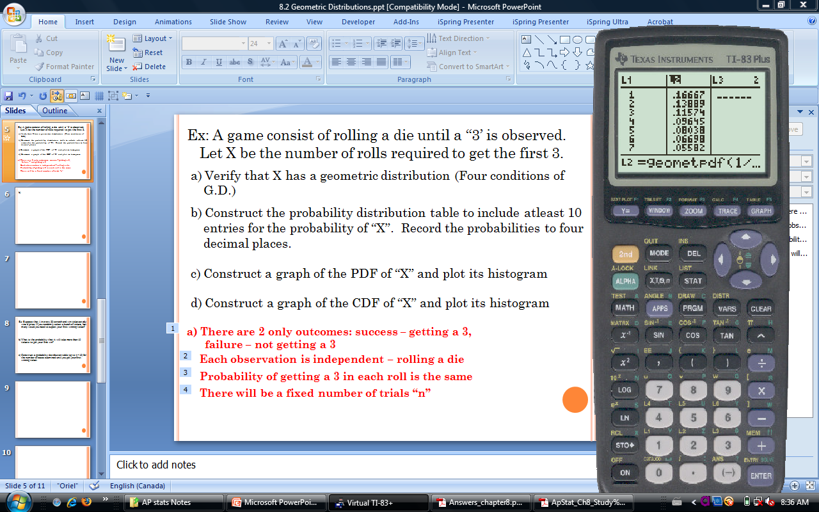
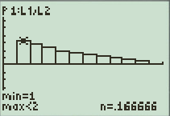
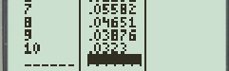
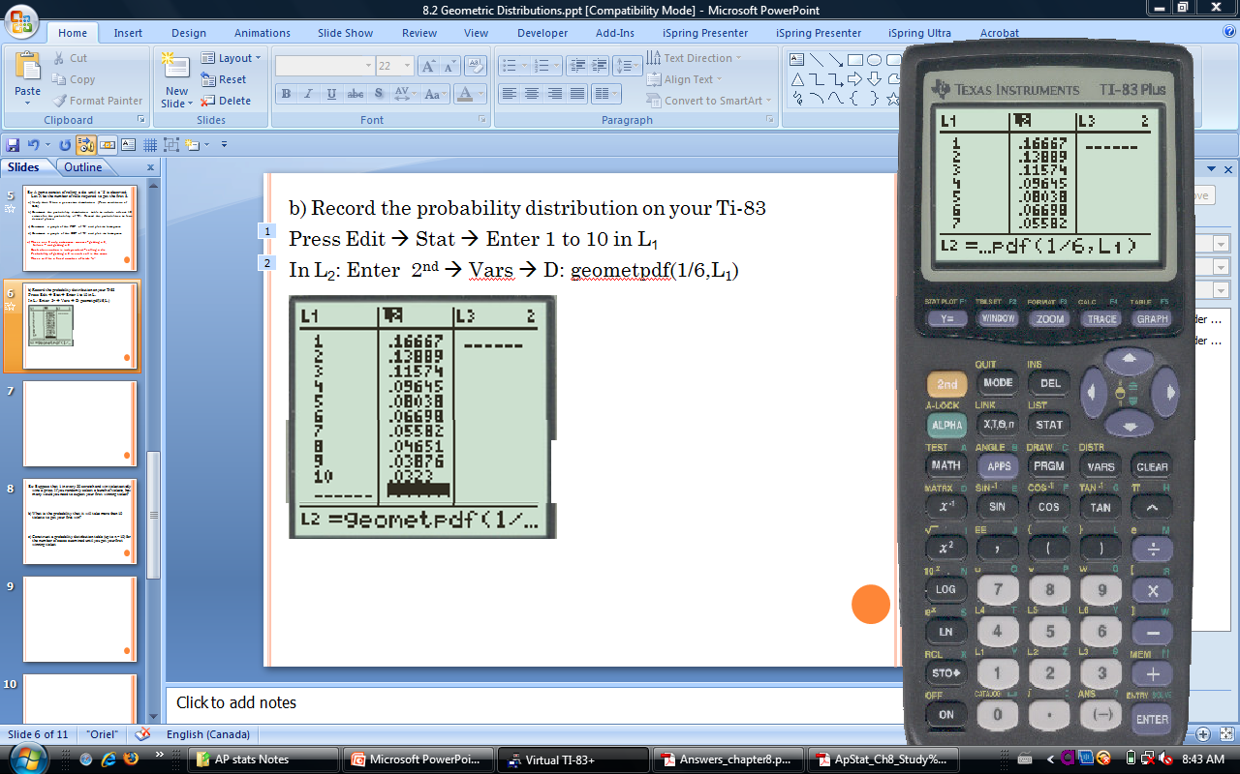
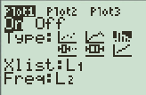
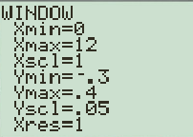
B & C) Record the probability distribution (PDF) on your Ti-83
Press Edit → Stat → Enter 1 to 10 in L₁
In L₂: Enter 2nd → Vars → D: geometpdf(1/6,L₁)
Histogram of the
PDF of “X”

Slide 36
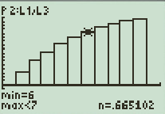
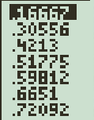
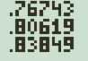
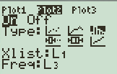
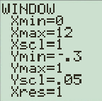
c) & d) Record the cumulative probability distribution (CDF) on your Ti-83
In L₂: Enter 2nd → Vars → E: geometcdf(1/6,L₁)
Histogram of the CDF of “X”

Slide 37
Game of STOCKS
6 rounds, collect points as two dice are rolled
Round is over when a pair is rolled
You must sit before a pair is rolled, otherwise all your points that round will be removed
When a double is rolled, all your points from all previous round will be removed if you are still standing
The first 3 rolls of each round will be pair free
Team with the most points at the end of 6 rounds win
Dice Rolling APPLET

Slide 38
Ex: Suppose that 1 in every 20 scratch and win ticket actually wins a prize. If you randomly select a bunch of tickets, how many would you need to expect your first winning ticket?
b) What is the probability that it will take more than 10 tickets to get your first win?
c) Construct a cumulative probability distribution (CDF) table (up to n = 20) for the number of cases examined until you get your first winning ticket
An expected value of 20 indicates that we would expect 20 tickets to get our first winning ticket

Slide 39
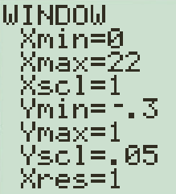
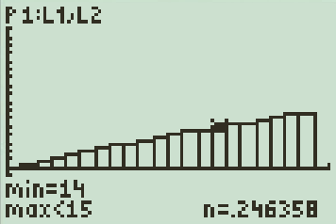
c) Probability Distribution Table: Press: STAT → Edit → Enter 1 to 10 in L1
GO to L2 and Enter: 2nd → VARS → E:geometcdf (0.02,L1)

Slide 40
Ex: Government data reveal that approximately 65% of all divorce cases cite incompatibility as the underlying cause. Let “X” be the number of divorce cases that cite incompatibility.
A) You randomly select divorce cases to study. How many cases would you expect to see until you see one that cites incompatibility as the cause?
B) What is the probability that it takes more than 4 cases to find one that cites incompatibility?
C) Construct a probability distribution table (up to n = 5) for the number of cases examined until you find one that cites incompatibility.
D) Sketch a probability histogram (PDF) (out to n = 5) for your table in Question “C”.

Slide 41
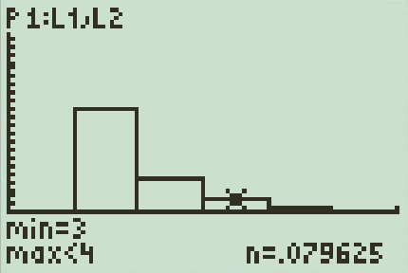
a)
(Note: “Between 1 and 2” is correct and acceptable, but an integer is not correct)
c)
b)
d)

Slide 42
A person has a 15% chance of winning a daily office game. What is the probability that she first wins on the fifth day?

